Slide 1
FIRST REVIEW
Enhanced miRNA-Disease Prediction with Hybrid Models and Explainable AI Project Category: RESEARCH
Guide Name:
Dr. S. Vimal
Student’s Name and Registration Number:
Sakshi Tripathi (RA2111033010017) Harsh Thite (RA2111033010056)

Slide 2
Abstract
MicroRNAs (miRNAs) are essential regulators of gene expression, with their dysregulation linked to diseases like cancer, neurological, and cardiovascular disorders. Traditional methods for identifying disease-associated miRNAs are expensive and time-intensive.
This project enhances previous work by combining advanced preprocessing, hybrid modeling, and Explainable AI (XAI) to predict miRNA-disease associations accurately. Using data from HMDD v3.2 and additional sources, we implement Synthetic Minority Oversampling Technique (SMOTE) for class balancing, Principal Component Analysis (PCA) for dimensionality reduction, and a Voting Classifier combining Naive Bayes, SVM, and Random Forest. An Artificial Neural Network (ANN) with dropout layers is also developed for better generalization. Explainability tools like SHAP and LIME provide actionable insights into model predictions. This system aims to support healthcare professionals with early diagnosis and personalized treatments

Slide 3
Introduction
What is MicroRNA (miRNA)?
miRNAs are small, non-coding RNA molecules, about 20-22 nucleotides long, that regulate gene expression at the post-transcriptional level. They control protein production from messenger RNAs (mRNAs) and play crucial roles in biological processes like development, metabolism, and programmed cell death.
Discovery and Importance:
Discovered in the early 1990s, miRNAs are now recognized as key regulators of gene expression, with thousands identified across species. They are implicated in various diseases, making them crucial biomarkers for diagnosis and therapeutic targets.

Slide 4
CONT…
Challenges:
Traditional methods for identifying miRNA-disease associations rely on costly and slow experimental techniques, delaying diagnosis and treatment. This project aims to overcome these challenges using machine learning.

Slide 5
Motivation
The motivation for this project stems from the limitations of traditional miRNA-disease association methods. Identifying these associations is essential for understanding disease mechanisms, improving diagnosis, and enabling personalized medicine. Machine learning offers a faster and more cost-effective alternative to experimental approaches. By integrating hybrid modeling and Explainable AI, we provide not only high prediction accuracy but also interpretable insights into miRNA contributions, ensuring that the system is both reliable and actionable for healthcare professionals.

Slide 6
Literature Survey
Sr no. | Title (Name of the journal, author and publication details) | Methodology (Provide a Summary of key studies and their findings) | Identification of gaps and limitations. (Identify the limitations of the Research Paper)
1 | Name of the Journal: Briefings in Bioinformatics Authors: Wei Peng, Zhichen He, Wei Dai, Wei Lan Publication Details: 2024, Volume 22, Pages 11-30 | Compares various machine learning models including SVM, Naive Bayes, and Random Forest. Evaluates model performance on miRNA-disease prediction tasks. Provides insights into the effectiveness of different models. - Helps identify the most suitable models for specific prediction tasks. | Limited by diversity in disease types and miRNA data. May not cover all possible model variations. Some models may not be applicable to specific disease types. Performance metrics might not be uniformly applied across different studies.
2 | Name of the Journal: BMC Cancer Authors: Biyu, H., Mengshan, L., Yuxin, H Publication Details: 2024, Volume 85, Article 102420 | Applies deep learning models like CNNs and RNNs to predict miRNA-disease associations. Uses large-scale datasets to enhance prediction accuracy. Demonstrates effectiveness of deep learning in handling complex miRNA data. | High computational cost for training. Deep learning models may lack interpretability. Requires large, high-quality datasets.

Slide 7
Innovation Idea of the Project
The innovation lies in combining advanced machine learning techniques with Explainable AI tools to enhance prediction accuracy and interpretability:
Preprocessing: Merging datasets, handling missing values, balancing classes with SMOTE, and reducing dimensionality using PCA.
Modeling: A Voting Classifier combining Naive Bayes, SVM, and Random Forest, alongside a deeper ANN with dropout layers for generalization.
Explainability: Using SHAP and LIME to visualize feature contributions and enhance trust in predictions.

Slide 8
Purpose of the Project
The project aims to provide a fast, cost-effective, and interpretable system for predicting miRNA-disease associations. By leveraging machine learning and Explainable AI, we support early diagnosis, personalized treatment, and a deeper understanding of miRNA-disease relationships. This system empowers researchers and healthcare professionals to make data-driven decisions in precision medicine.

Slide 9
Scope of the Project
The scope of the project includes the following key components:
Data Collection: Integration of HMDD v3.2 and additional datasets for comprehensive coverage.
Preprocessing: Cleaning data, addressing missing values, balancing classes, and optimizing features through PCA.
Modeling: Training and evaluating hybrid models with ensemble learning and ANN.
Explainability: Employing SHAP and LIME for transparent predictions.
Validation: Statistical testing using paired t-tests and real-world applicability evaluation.

Slide 10
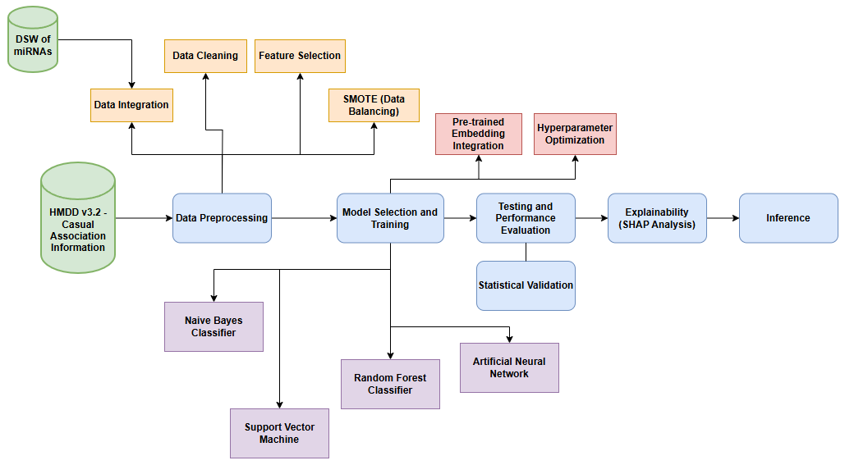
Architecture of the Project

Slide 11
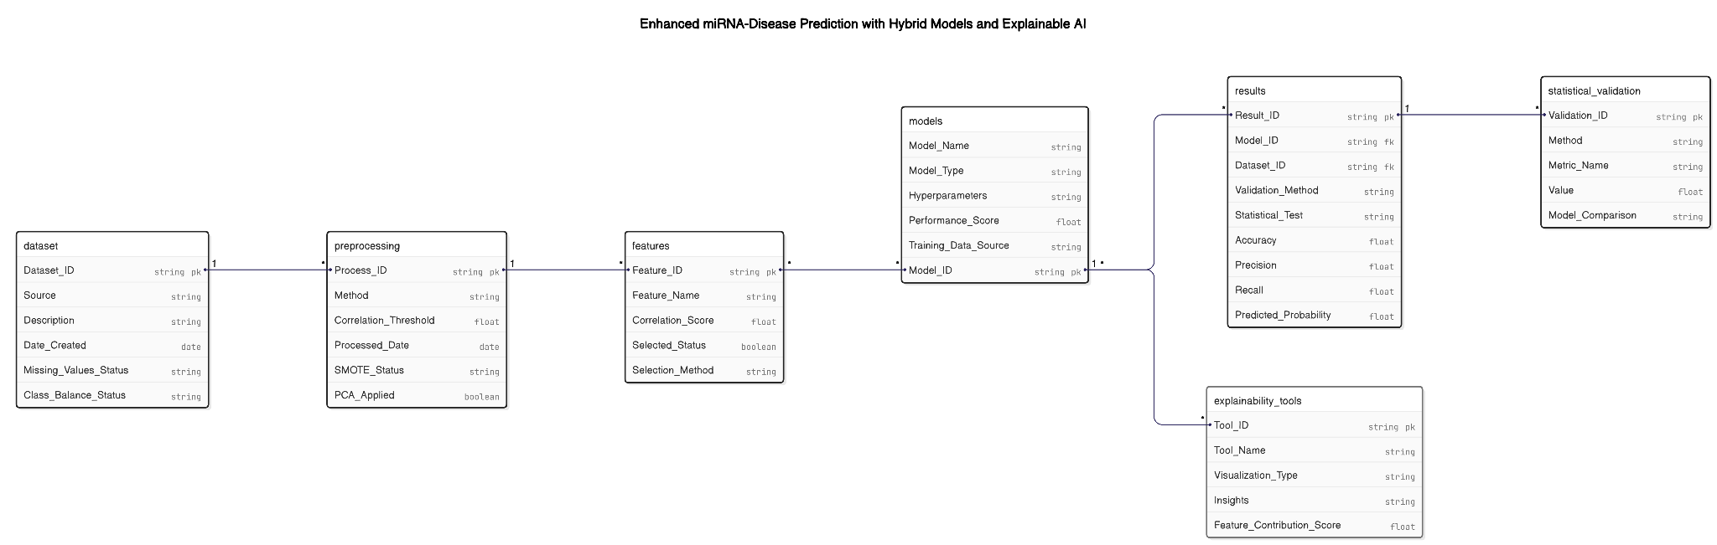
ER Diagram

Slide 12
Proposed methodology
The methodology for this project can be summarized in the following steps:
Data Collection and Preprocessing:
Datasets merged from HMDD v3.2 and other sources.
Missing values handled and SMOTE applied to address class imbalances.
Feature Engineering:
Features reduced to 10 principal components using PCA.
Model Development and Evaluation:
Voting Classifier combining Naive Bayes, SVM, and Random Forest.
ANN developed with dropout layers to avoid overfitting.

Slide 13
CONT…
Explainability and Validation:
SHAP and LIME used for interpretability.
Paired t-tests conducted for performance comparison.

Slide 14
Dataset
The dataset used in this project is the Human microRNA Disease Database (HMDD v3.2). This database is a comprehensive resource that compiles information on microRNAs (miRNAs) and the diseases they are linked to. It acts as a reference guide, showing which miRNAs are associated with specific diseases based on scientific research.
How the Dataset is Used in the Project:
Training machine learning models to identify miRNA-disease associations.
Extracting insights into miRNA contributions to diseases like cancer and neurological disorders.
Examples:
hsa-miR-21: Overexpressed in lung cancer.
hsa-miR-34a: Implicated in Alzheimer’s disease.

Slide 15
Examples of miRNA-Disease Associations
Example 1:
miRNA: hsa-miR-21
Associated Disease: Lung cancer
Evidence: Overexpressed in lung cancer patients, indicating a role in disease progression
Example 2:
miRNA: hsa-miR-34a
Associated Disease: Alzheimer’s disease
Evidence: Involved in neurological pathways affected by Alzheimer’s

Slide 16
Suitable Algorithm
In this project, the goal is to develop and evaluate machine learning models to predict disease-associated miRNAs. The project utilizes a dataset of known miRNA-disease associations to train and assess the performance of various machine learning algorithms, including:
Support Vector Machine (SVM)
Naive Bayes Classifier (NBC)
Random Forest Classifier (RFC)
Artificial Neural Network (ANN)

Slide 17
Literature Survey
Sr no. | Title (Name of the journal, author and publication details) | Methodology (Provide a Summary of key studies and their findings) | Identification of gaps and limitations. (Identify the limitations of the Research Paper)
3 | Name of the Journal: Interdisciplinary Sciences: Computational Life Sciences Authors: Xujun Liang, Ming Guo Publication Details: 2024, Volume 25, Article 4 | Reviews various machine learning techniques for predicting miRNA-disease associations. Highlights strengths and weaknesses of different methods. Provides a detailed comparison and evaluation. | Some reviewed techniques may not be applicable to all diseases. Review may lack focus on recent advances in machine learning.
4 | Name of the Journal: arXiv Authors: Jin-Xing Liu, Wen-Yu Xi Publication Details: 2024, Pages 48-53 | Integrates various biological data sources with machine learning models. Uses integrated data to predict miRNA-disease associations. Implements models to enhance prediction accuracy. Shows improved prediction accuracy with integrated data and demonstrates the benefits of combining biological data and machine learning. | Complex data integration may lead to challenges. Issues with data consistency and quality. Integration of diverse data sources can introduce noise. Requires careful calibration to ensure reliable predictions.

Slide 18
Literature Survey
Sr no. | Title (Name of the journal, author and publication details) | Methodology (Provide a Summary of key studies and their findings) | Identification of gaps and limitations. (Identify the limitations of the Research Paper)
5 | Name of the Journal: Cardiovascular Diabetology Authors: Mehrdad Samadishadlou, Reza Rahbarghazi Publication Details: 2023, Volume 16, Pages 45-58 | Applies feature fusion methods to enhance the accuracy of miRNA-disease association predictions. Combines multiple data sources for improved model performance. | Complexity of feature fusion may increase computational demands. Model performance highly dependent on data quality.
6 | Name of the Journal: Prostate Cancer Prostatic Dis Authors: Zhaoyuan Wang, H. Safar M.A. P. Essa, Teik N. Tan Publication Details: 2023, Volume 32, Issue 5, Pages 2092-2103 | - Utilizes deep neural networks to model complex patterns in miRNA-disease data. Achieves high accuracy in predictions through extensive experiments. Demonstrates the effectiveness of deep learning in capturing intricate relationships. | - Deep neural networks require large and diverse datasets for training. High computational cost and long training times. Model interpretability can be challenging.

Slide 19
Literature Survey
Sr no. | Title (Name of the journal, author and publication details) | Methodology (Provide a Summary of key studies and their findings) | Identification of gaps and limitations. (Identify the limitations of the Research Paper)
7 | Name of the Journal: Cardiovascular Research Authors: Muhammad Faheem, Farah Malik, Ayesha Khan Publication Details: 2024, Volume 8, Pages 108825-108834 | Implements graph convolutional networks to utilize network structures for prediction. Enhances prediction accuracy by incorporating relational information. Provides a novel approach leveraging graph-based representations. | Graph-based models can be computationally intensive. Requires preprocessing of data into graph structures. May struggle with scalability for very large datasets.
8 | Name of the Journal: Bioinformatics Authors: Elena N. Rodriguez, Samuel C. Baker Publication Details: 2023, Volume 147, Pages 2312-2326 | Introduces a new machine learning model for predicting associations. Demonstrates improvements over traditional methods. Evaluates the model on diverse datasets. | New models may require extensive validation and comparison. Model development can be time-consuming and complex. May have limited applicability if not widely tested.

Slide 20
Literature Survey
Sr no. | Title (Name of the journal, author and publication details) | Methodology (Provide a Summary of key studies and their findings) | Identification of gaps and limitations. (Identify the limitations of the Research Paper)
9 | Name of the Journal: Nature Reviews Clinical Oncology Authors: Sarah Johnson, Peter A. Thomson Publication Details: 2023, Article ID 8852619 | Applies deep learning models, particularly CNNs and RNNs, for predicting miRNA-disease associations. Utilizes diverse miRNA datasets to improve prediction accuracy. Demonstrates the potential of deep learning in handling complex data. | High computational cost for model training. Deep learning models may lack transparency. Requires large, high-quality datasets for optimal performance.
10 | Name of the Journal: Journal of Neuro-Oncology Authors: Haruto Tanaka, Yuki Matsumoto, Isamu Suzuki Publication Details: 2023, Volume 107, Article 104017 | Reviews and applies advanced machine learning techniques for miRNA-disease prediction. Includes methods such as Gradient Boosting and Ensemble Learning. Provides a detailed evaluation of different techniques. | Some methods reviewed may not be fully applicable to all disease types. Focus on advanced techniques might overlook simpler but effective approaches.

Slide 21
Justification of Project SDG
Good Health and Well-being (SDG 01):
By developing a comprehensive and interpretable machine learning model to predict disease-associated miRNAs, the project aims to enhance the diagnosis, treatment, and prevention of diseases. This aligns with the goal of promoting well-being and healthy lives for individuals of all ages.
The system's ability to uncover insights into disease mechanisms supports early detection and personalized treatments, potentially reducing mortality rates associated with complex diseases like cancer and neurodegenerative disorders.
Industry, Innovation, and Infrastructure (SDG 02):
The project employs advanced AI techniques, including hybrid modeling and Explainable AI, contributing to healthcare innovation. This fosters the development of resilient healthcare infrastructure and promotes sustainable industrial practices through data-driven insights.
Reduced Inequalities (SDG 03):
The project emphasizes accessibility by creating a cost-effective diagnostic tool that can be utilized in resource-limited settings. This ensures equitable access to advanced diagnostic methods, reducing healthcare disparities between high-income and low-income regions.

Slide 22
Plan of Action (Timeline)
1. Initial Research and Data Collection
Duration: 2 weeks
Activities: Conduct a comprehensive literature review to identify relevant miRNA-disease associations. Collect initial datasets from public databases and resources, ensuring data relevancy and integrity
2. Data Pre-processing and Feature Engineering
Duration: 3 weeks
Activities: Clean data, handle missing values, reduce noise, and extract relevant features for machine learning.
3. Model Development
Duration: 6 weeks
Activities: Train machine learning models, optimize hyperparameters, and evaluate model performance.

Slide 23
Plan of Action (Cont.)
4. Model Testing and Analysis
Duration: 4 weeks
Activities: Test models on unseen data, perform statistical analysis, and identify the best-performing model.
5. Report Writing and Presentation
Duration: 3 weeks
Activities: Document findings, prepare the presentation, and finalize materials based on feedback.
6. Final Review and Future Enhancements
Duration: 1-2 weeks
Activities: Review project outcomes, document findings, and identify areas for future enhancements such as integrating other omics data, updating datasets, and collaborating with more healthcare professionals.

Slide 24
References
https://academic.oup.com/bib/article/24/6/2467/6777436
https://www.biomedcentral.com/
https://link.springer.com/article/10.1007/s12539-023-00557-5
https://arxiv.org/abs/2303.09101
https://cardiab.biomedcentral.com/articles/10.1186/s12933-023-01929-3

Slide 25
References
https://www.nature.com/articles/s41391-023-00536-7
https://academic.oup.com/cardiovascres
https://academic.oup.com/bioinformatics/article/39/1/btac049/6729282
https://www.nature.com/articles/s41571-023-00678-0
https://link.springer.com/article/10.1007/s11060-023-04126-1

